Slide 1
GGO and Bronchiectasis Segmentation
Dr. Victoria Mazo

Slide 2
Content
Motivation
Datasets
Network architecture
Results
Examples

Slide 3
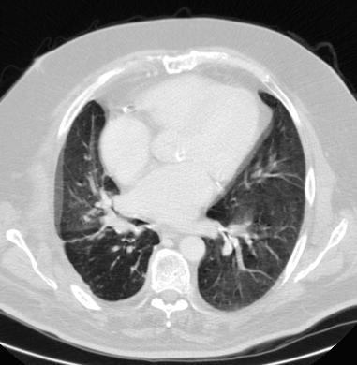
Motivation
Ground Glass Opacity
Ground Glass Opacity appears as a hazy, vaguely bounded region in the lungs on a CT
Focal regions of GGO might be malignant
Small regions of GGO are often very subtle and thus prone to being overlooked

Slide 4
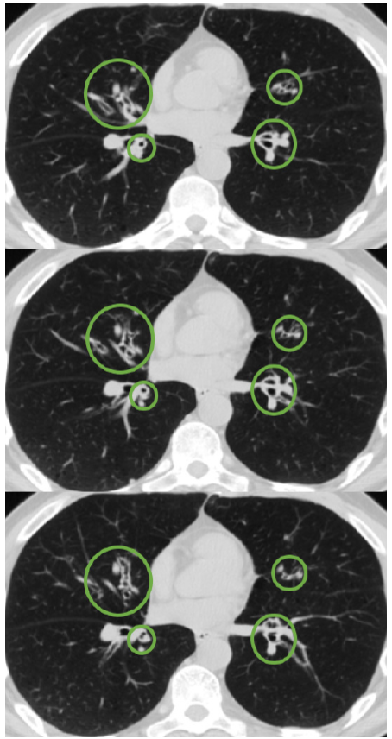
Motivation
Bronchiectasis
Bronchiectasis is defined to be a localized irreversible dilation of bronchial walls
More than 25% of all patients carrying a diagnosis of Chronic Obstructive Pulmonary Disease (the 4th leading cause of death worldwide)
If broncho-arterial ratio is greater than 1, it is believed to be bronchiectasis

Slide 5
Motivation
Previous approaches using manually engineered features suffer from overfitting and large number of false positives
As a rule, previous approaches used very small datasets (~100 segmented slices)
Deep Learning has emerged as a powerful approach to learning imaging representations directly from large volumes of data
Segmentation with Fully Convolutional Networks has shown promising results on natural images

Slide 6
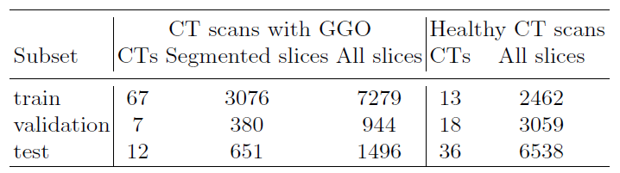
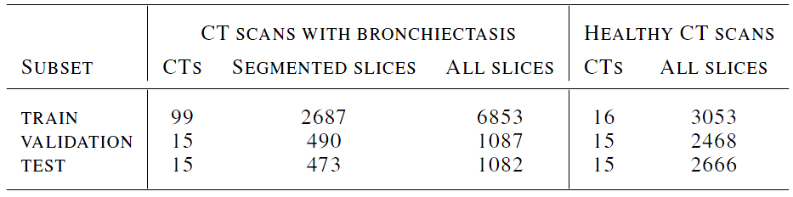
Datasets
4107 segmented slices with GGO
3650 segmented slices with bronchiectasis

Slide 7
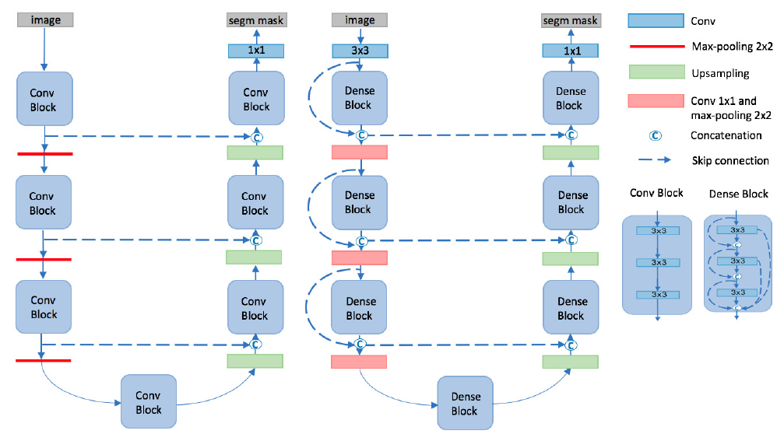
U-Net and FC-DenseNet Architectures
U-Net
FC-DenseNet

Slide 8
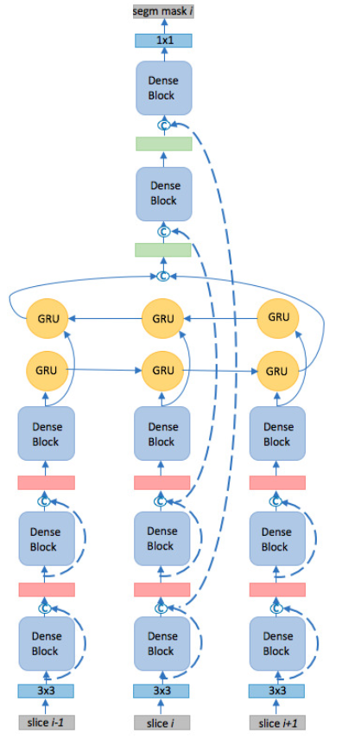
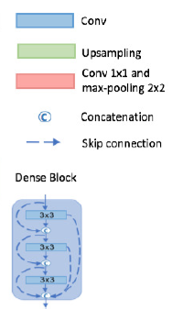
Recurrent FC-DenseNet Architecture

Slide 9
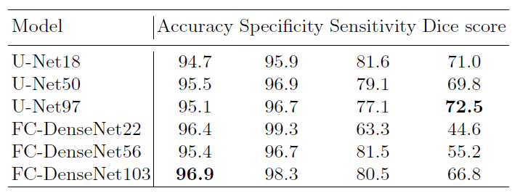
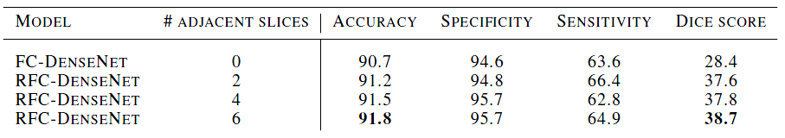
Classification Results
GGO classification (per slice)
Bronchiectasis classification (per slice)

Slide 10
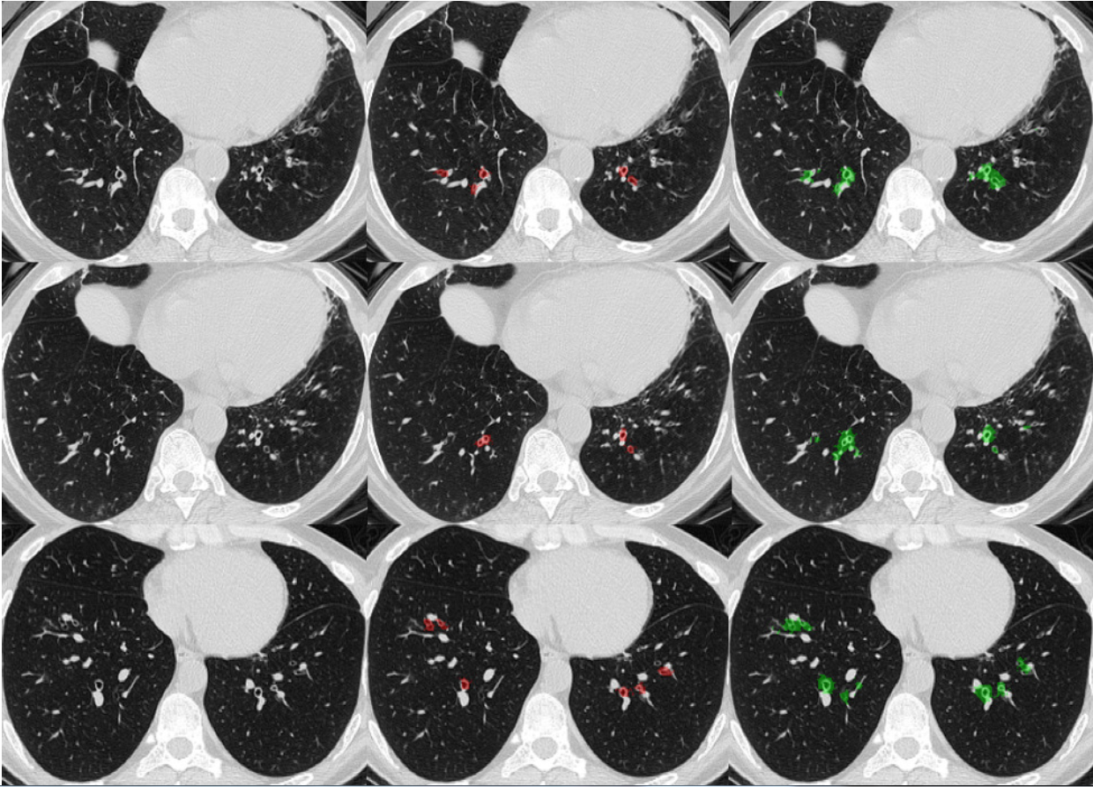
Bronchiectasis
Ground truth
Prediction

Slide 11
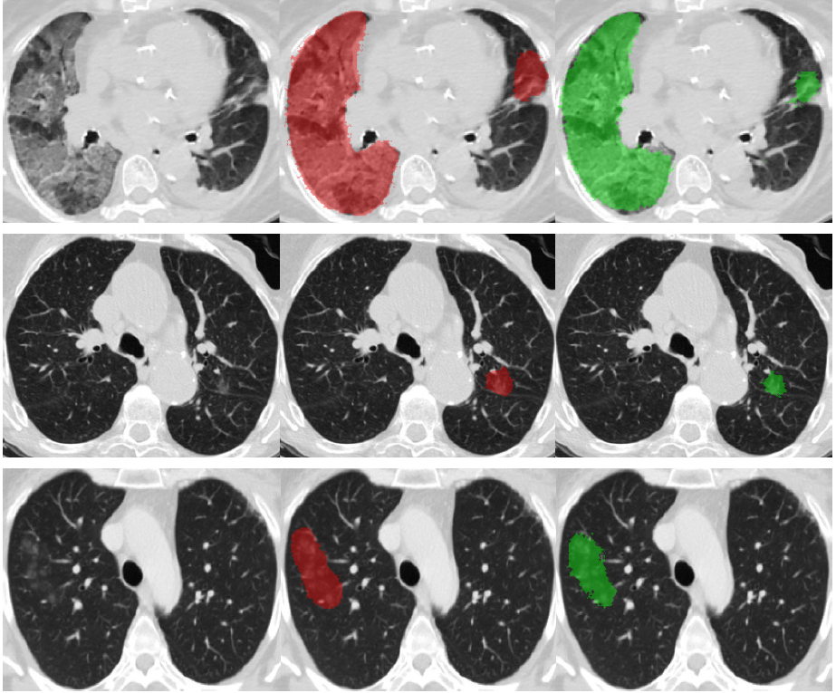
Ground Glass Opacity
Ground truth
Prediction

